Slide 1

MOBILE DEVELOPMENT
COMPUTER SCIENCE
Topic 3:
Programming User Interfaces
version 1.0
Copyright © 2020 by Singapore Institute of Management Pte Ltd. All rights reserved.

Slide 2

Learning Outcomes
After studying this topic and the recordings online, you should be able to:
Topic 3 – Programming User Interface
React JS Structure
JSX and Props
React Native Hooks
UI Elements
Touchable Elements

Slide 3

React Js Structure
There are THREE (3) primary parts in a React file:
The import/export structure
The layout structure
The style structure
Notes:
B

Slide 4
React Js Structure
The import structure
This is the standard structure for a newly created React js file.
Allows importing external components by writing a new import statement line.
import { StatusBar } from 'expo-status-bar'; import { StyleSheet, Text, View } from 'react-native';
Notes:
B

Slide 5
React Js Structure
The import structure
Every module is said to have at most one default export.
In order to import the default export from a file, we can use only the address and use the keyword import before it, or we can give a name to the import making the syntax as the following.
import GIVEN_NAME from ADDRESS
Notes:
B

Slide 6
React Js Structure
The import structure
Importing named values: Every module can have several named parameters and in order to import one we should use the syntax as follows.
import { PARA_NAME } from ADDRESS
Notes:
B

Slide 7
React Js Structure
The import structure
And similarly, for multiple such imports, we can use a comma to separate two-parameter names within the curly braces.
In order to import a combination, we should use the following syntax.
import GIVEN_NAME, { PARA_NAME, ... } from ADDRESS
Notes:
B

Slide 8
React Js Structure
The export structure
Now, importing is an operation that requires the permission of the module.
Importing is possible only if the module or named property to be imported has been exported in its declaration.
In React we use the keyword export to export a particular module or a named parameter or a combination.
Notes:
B

Slide 9
React Js Structure
The export structure
In order to export the default export from a file, we need to follow the syntax described below.
export default GIVEN_NAME
Notes:
B

Slide 10
React Js Structure
The export structure
Every module can have several named parameters and in order to export one we should use the syntax as follows.
export { PARA_NAME }
Notes:
B

Slide 11
React Js Structure
The layout structure
This structure holds elements that formulates the page look and feel.
export default function App() { return ( <View style={styles.container}> <Text>Open up App.js to start working on your app!</Text> <StatusBar style="auto" /> </View> ); }
Notes:
B

Slide 12
React Js Structure
The layout structure
Similar to HTML, each element start/end tag defines an object for React to render.
<Text>Open up App.js to start working on your app!</Text>
<Button onPress = {handlePress} title = "Red button!" color = "red" />
Notes:
B

Slide 13
React Js Structure
The style structure
The style structure is supported by the StyleSheet import.
Similar to CSS, all elements’ style are written in the const styles structure.
Notes:
B

Slide 14
React Js Structure
The style structure
In this case, the container represents the name of this style and within the braces the style properties are placed in it.
const styles = StyleSheet.create({ container: { flex: 1, backgroundColor: '#fff', alignItems: 'center', justifyContent: 'center', }, });
Notes:
B

Slide 15
React Js Structure
The style structure
To apply styles to our container, we need to add style={styles.container} property to the View element.
<View style={styles.container} > <Text>Open up App.js to start working on your app!</Text> <StatusBar style="auto" /> </View>
Notes:
B

Slide 16
JSX and Props
The following is a funny tag syntax which is neither a string nor HTML.
It is called JSX, and it is a syntax extension to JavaScript.
It is highly used with React to describe what the UI should look like.
JSX may remind you of a template language, but it comes with the full power of JavaScript.
const element = <h1>Hello, world!</h1>;
Notes:
B

Slide 17
JSX and Props
React embraces the fact that rendering logic is inherently coupled with other UI logic:
How events are handled
How the state changes over time
How the data is prepared for display.
Notes:
B

Slide 18
JSX and Props
Instead of artificially separating technologies by putting markup and logic in separate files, React separates concerns with loosely coupled units called “components” that contain both.
React doesn’t require using JSX, but most people find it helpful as a visual aid when working with UI inside the JavaScript code.
It also allows React to show more useful error and warning messages.
Notes:
B

Slide 19
JSX and Props
Embedding Expressions in JSX
In the example below, we declare a variable called name and then use it inside JSX by wrapping it in curly braces:
You can put any valid JavaScript expression inside the curly braces in JSX.
const name = 'Josh Perez'; const element = <h1>Hello, {name}</h1>;
Notes:
B

Slide 20
JSX and Props
Embedding Expressions in JSX
In the example below, we embed the result of calling a JavaScript function, formatName(user), into an <Text> element.
function formatName(user) { return user.firstName + ' ' + user.lastName; } const user = { firstName: 'Harper', lastName: 'Perez' };
Notes:
B

Slide 21
JSX and Props
Embedding Expressions in JSX
In the example below, we embed the result of calling a JavaScript function, formatName(user), into an <Text> element.
(Continued)
<Text>Hello, {formatName(user)}!</Text>
Notes:
B

Slide 22
JSX and Props
Props
Most components can be customized when they are created, with different parameters.
These created parameters are called props, short for properties.
Notes:
B

Slide 23
JSX and Props
Props
For example, one basic React Native component is the Image. When you create an image, you can use a prop named source to control what image it shows.
const pic = { uri: 'https://upload.wikimedia.org/wikipedia/commons/d/de/Bananavarieties.jpg' }; return ( <Image source={pic} style={{width: 193, height: 110, marginTop:50}}/> );
Notes:
B

Slide 24
Demonstration for first assignment
Now we are clear about the structure and components of React JS.
I will demonstrate how to build the name badge application.
Notes:
B

Slide 25
React Native Hooks
The state of your application is bound to change at some point. This could be the value of a variable, an object, or whatever type of data exists in your component.
To make it possible to have the changes reflected in the DOM, we have to use a React hook called useState.
Notes:
B

Slide 26
React Native Hooks
To be able to use this hook, you have to import the useState hook from React.
import { useState } from "react";
Notes:
B

Slide 27
React Native Hooks
After that, you have to create your state and give it an initial value (or initial state) which is “Mobile Development".
The state variable is called name, and setName is the function for updating its value.
const [name, setName] = useState(“Mobile Development");
Notes:
B

Slide 28
React Native Hooks
Looks like this:
export default function App() { const [name, setName] = useState("Mobile Development"); const changeName = () => { setName("Hello World"); }; return ( <View style={styles.container}> <Text>My name is {name}</Text> <Button onPress = {changeName} title = "Click here" color = "red" /> </View> ); }
Notes:
B

Slide 29
UI Elements
View Element
View is the most common element in React Native.
You can consider it as an equivalent of the div element used in web development.
Notes:
B

Slide 30
UI Elements
View Element
Purpose:
When you need to wrap your elements inside the container, you can use View as a container element.
When you want to nest more elements inside the parent element, both parent and child can be View. It can have as many children as you want.
Notes:
B

Slide 31
UI Elements
View Element
Purpose:
When you want to style different elements, you can place them inside View since it supports style property, flexbox etc.
View also supports synthetic touch events, which can be useful for different purposes.
Notes:
B

Slide 32
UI Elements
View Element
Code:
<View> <View> <Text>This is my text</Text> </View> </View>
Notes:
B

Slide 33
UI Elements
ActivityIndicator Element
React Native ActivityIndicator is a component for displaying loading action.
It is the same as the circular loader/Progress Bar.
It is used to show the progress of long-running task so that the user can understand something is in progress.
Notes:
B

Slide 34
UI Elements
ActivityIndicator Element
To import ActivityIndicator in the Code:
Using ActivityIndicator:
import { ActivityIndicator} from 'react-native'
<ActivityIndicator size="large" color="#0000ff" />
Notes:
B

Slide 35
UI Elements
Button Element
Buttons are touchable elements used to interact with the screen. They may display text, icons, or both.
Buttons can be styled with several props to look a specific way.
Notes:
B

Slide 36
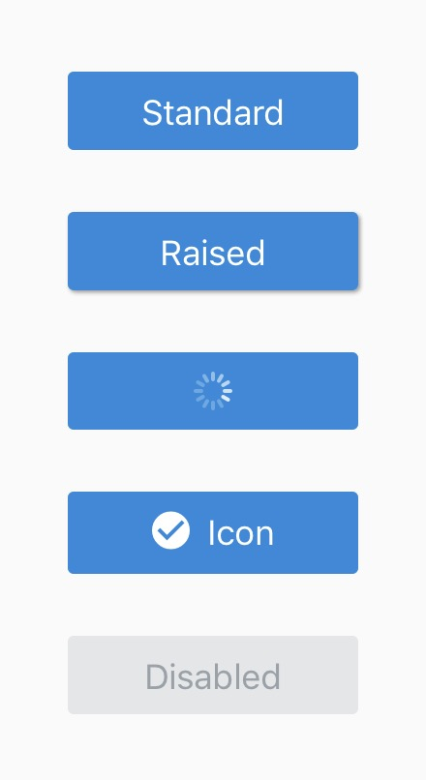
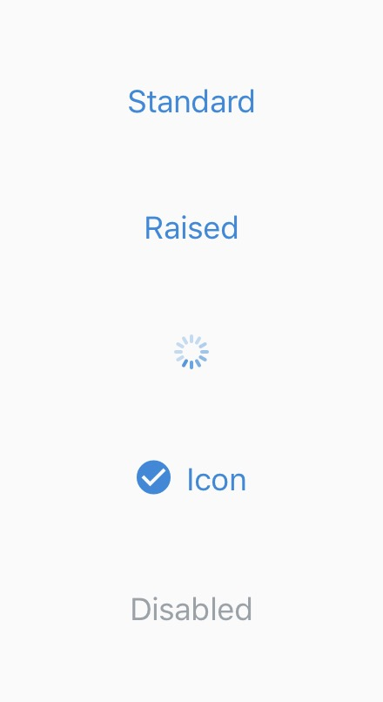
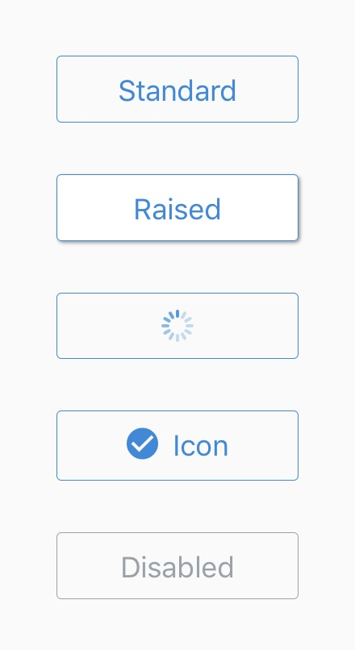
UI Elements
Button Element
Notes:
B

Slide 37
UI Elements
Button Element
To import Button in the Code:
Using Button:
import { Button } from 'react-native'
<Button onPress = {testButton} title = "Red button!" color = "red" />
Notes:
B

Slide 38
UI Elements
Button Element
Configuring the action’s of the Button:
export default function App() { function testButton(){ alert("Hello World"); } return ( ….
Notes:
B

Slide 39
UI Elements
Switch Element
This is a controlled component that requires an onValueChange callback that updates the value prop in order for the component to reflect user actions.
If the value prop is not updated, the component will continue to render the supplied value prop instead of the expected result of any user actions.
Notes:
B

Slide 40
UI Elements
Switch Element
To import Switch in the Code:
Implement prop in the Code (set default to false):
import { useState } from "react"; import {Switch} from "react-native";
const [isEnabled, setIsEnabled] = useState(false); const toggleSwitch = () => setIsEnabled(previousState => !previousState);
Notes:
B

Slide 41
UI Elements
Switch Element
To add Switch in the Code:
<View style={styles.container}> <Switch trackColor={{ false: "#767577", true: "#81b0ff" }} thumbColor={isEnabled ? "#f5dd4b" : "#f4f3f4"} ios_backgroundColor="#3e3e3e" onValueChange={toggleSwitch} value={isEnabled} /> </View>
Notes:
B

Slide 42
UI Elements
Image Element
A React component for displaying different types of images, including network images, static resources, temporary local images, and images from local disk, such as the camera roll.
Notes:
B

Slide 43
UI Elements
Image Element
The following demonstrates fetching and displaying an image from local storage as well as one from network and even from data provided in the 'data:' uri scheme.
Notes:
B

Slide 44
UI Elements
Image Element
Local storage images:
Before adding images, you have to store the images into the assets folder.
Notes:
B

Slide 45
UI Elements
Image Element
Local storage images:
To use the images, we have to import and add the element:
import { Image } from 'react-native'
<Image source = {require('./assets/favicon.png')} style={{width:100, height:100, resizeMode: "cover"}} />
Notes:
B

Slide 46
UI Elements
Image Element
Network images:
To use image from the net, we have to import and add the element using the uri attribute:
import { Image } from 'react-native'
<Image source = {uri: ‘url_link’} style={{width:100, height:100, resizeMode: "cover"}} />
Notes:
B

Slide 47
UI Elements
ImageBackground Element
A common feature request from developers familiar with the web is background-image.
To handle this use case, you can use the <ImageBackground> component, which has the same props as <Image>, and add whatever children to it you would like to layer on top of it.
Notes:
B

Slide 48
UI Elements
ImageBackground Element
A common feature request from developers familiar with the web is background-image.
To handle this use case, you can use the <ImageBackground> component, which has the same props as <Image>, and add whatever children to it you would like to layer on top of it.
Notes:
B

Slide 49
UI Elements
ImageBackground Element
To implement background images, we have to import and add the element:
import {ImageBackground } from 'react-native'
<View style={styles.container}> <ImageBackground source={uri: ‘image-url’} resizeMode="cover" style={styles.image}> <Text style={styles.text}>Inside</Text> </ImageBackground> </View>
Notes:
B

Slide 50
UI Elements
ImageBackground Element
To ensure that the background image covers/fits the entire screen, we would need to add certain styles:
const styles = StyleSheet.create({ container: { flex: 1, }, image: { flex: 1, justifyContent: "center" },
Notes:
B

Slide 51
UI Elements
ImageBackground Element
To ensure that the background image covers/fits the entire screen, we would need to add certain styles:
(Continue)
text: { color: "white", fontSize: 42, lineHeight: 84, fontWeight: "bold", textAlign: "center", backgroundColor: "#000000c0" } });
Notes:
B

Slide 52
Touchable Elements
If the basic button doesn't look right for your app, you can build your own button using any of the "Touchable" components provided by React Native.
The "Touchable" components provide the capability to capture tapping gestures, and can display feedback when a gesture is recognized.
These components do not provide any default styling, however, so you will need to do a bit of work to get them looking nicely in your app.
Notes:
B

Slide 53
Touchable Elements
Which "Touchable" component you use will depend on what kind of feedback you want to provide:
TouchableHighlight
TouchableNativeFeedback
TouchableOpacity
TouchableWithoutFeedback
Notes:
B

Slide 54
Touchable Elements
TouchableHighlight
You can use TouchableHighlight anywhere you would use a button or link on web.
The view's background will be darkened when the user presses down on the button.
Notes:
B

Slide 55
Touchable Elements
TouchableHighlight
Importing TouchableHighlight:
How to:
import {TouchableHighlight } from 'react-native'
<TouchableHighlight onPress={this.onPressButton}> <View style={styles.button}> <Text style={styles.buttonText}>TouchableHighlight</Text> </View> </TouchableHighlight>
Notes:
B

Slide 56
Touchable Elements
TouchableNativeFeedback
You may consider using TouchableNativeFeedback on Android to display ink surface reaction ripples that respond to the user's touch.
Notes:
B

Slide 57
Touchable Elements
TouchableNativeFeedback
Importing TouchableNativeFeedback:
import { TouchableNativeFeedback } from 'react-native'
Notes:
B

Slide 58
Touchable Elements
TouchableNativeFeedback
How to:
<TouchableNativeFeedback onPress={this.onPressButton} background={Platform.OS === 'android' ? TouchableNativeFeedback.SelectableBackground() : ''}> <View style={styles.button}> <Text style={styles.buttonText}>TouchableNativeFeedback {Platform.OS !== 'android' ? '(Android only)' : ''}</Text> </View> </TouchableNativeFeedback>
Notes:
B

Slide 59
Touchable Elements
TouchableOpacity
TouchableOpacity can be used to provide feedback by reducing the opacity of the button, allowing the background to be seen through while the user is pressing down.
Notes:
B

Slide 60
Touchable Elements
TouchableOpacity
Importing TouchableOpacity:
How to:
import {TouchableOpacity} from 'react-native'
<TouchableOpacity onPress={this.onPressButton}> <View style={styles.button}> <Text style={styles.buttonText}>TouchableOpacity</Text> </View> </TouchableOpacity>
Notes:
B

Slide 61
Touchable Elements
TouchableWithoutFeedback
If you need to handle a tap gesture but you don't want any feedback to be displayed, use TouchableWithoutFeedback.
Notes:
B

Slide 62
Touchable Elements
TouchableWithoutFeedback
Importing TouchableWithoutFeedback :
How to:
import {TouchableWithoutFeedback} from 'react-native'
<TouchableWithoutFeedback onPress={this.onPressButton}> <View style={styles.button}> <Text style={styles.buttonText}>TouchableWithoutFeedback</Text> </View> </TouchableWithoutFeedback>
Notes:
B

Slide 63
Touchable Elements
In some cases, you may want to detect when a user presses and holds a view for a set amount of time.
These long presses can be handled by passing a function to the onLongPress props of any of the "Touchable" components.
Notes:
B

Slide 64
Touchable Elements
How to:
<TouchableHighlight onPress={this.onPressButton} onLongPress={this.onLongPressButton}> <View style={styles.button}> <Text style={styles.buttonText}>Touchable with Long Press</Text> </View> </TouchableHighlight>
Notes:
B

Slide 65
That’s all for today!
If you have any questions, please feel free to reach out to me at this email.
kydsim001@mymail.sim.edu.sg
Notes:
B

Slide 66
END OF LESSON

